Slide 1
Lab 1: Preparing the Simulink
Auralius Manurung
2019

Slide 2
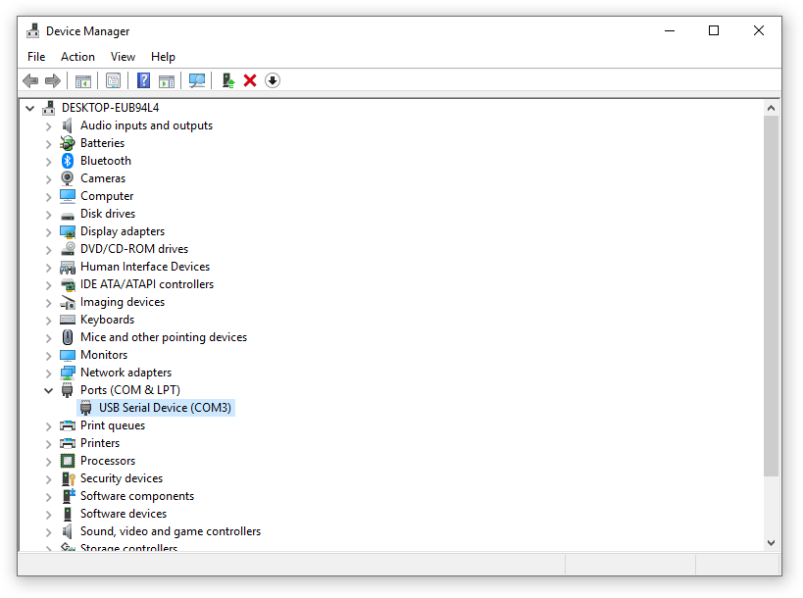
Check where is your Arduino Uno located
Open the device manager:

Slide 3
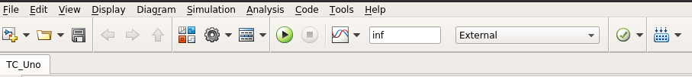
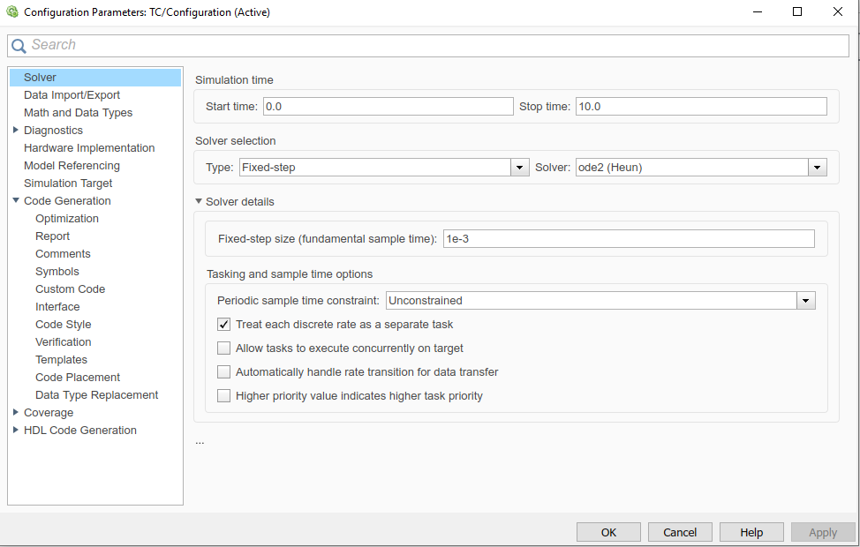
Configure your Simulink
Click the gear icon to open the configuration window
1 ms sampling time

Slide 4
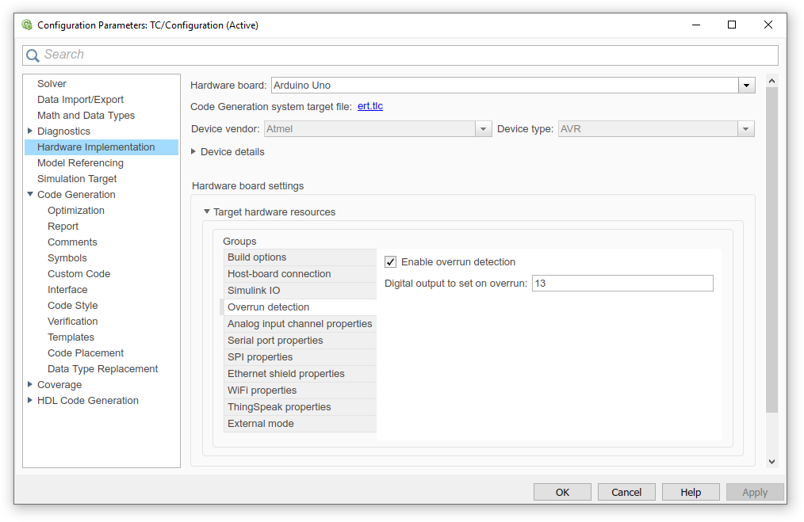
Configure your Simulink

Slide 5
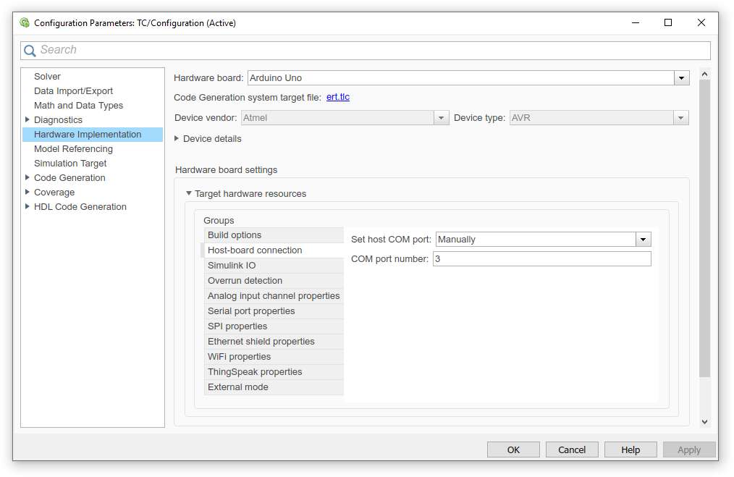
Configure your Simulink

Slide 6
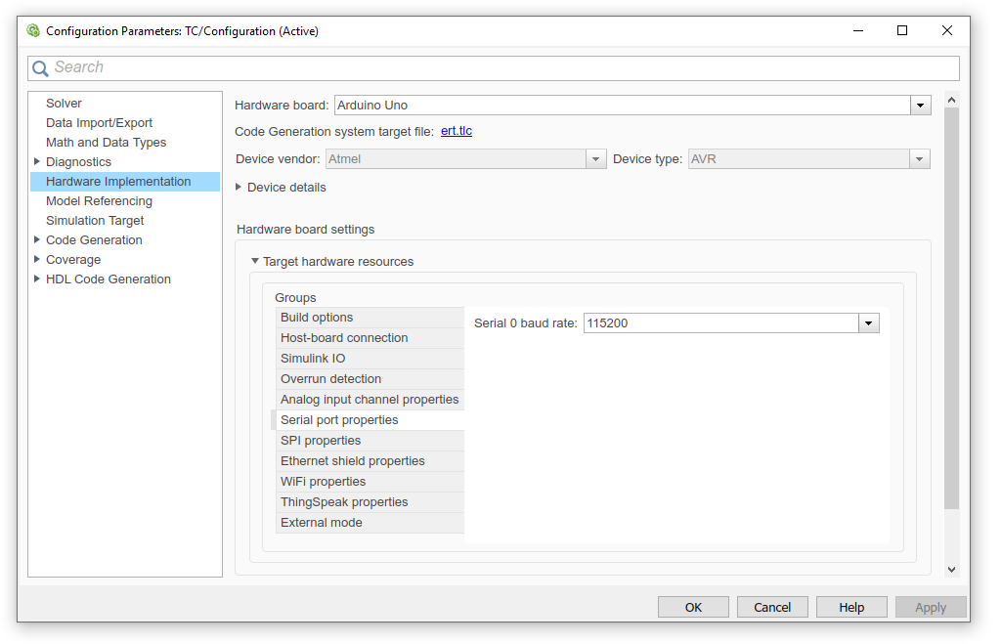
Configure your Simulink
If your MATLAB crashes a lot, reduce this to 9600.

Slide 7
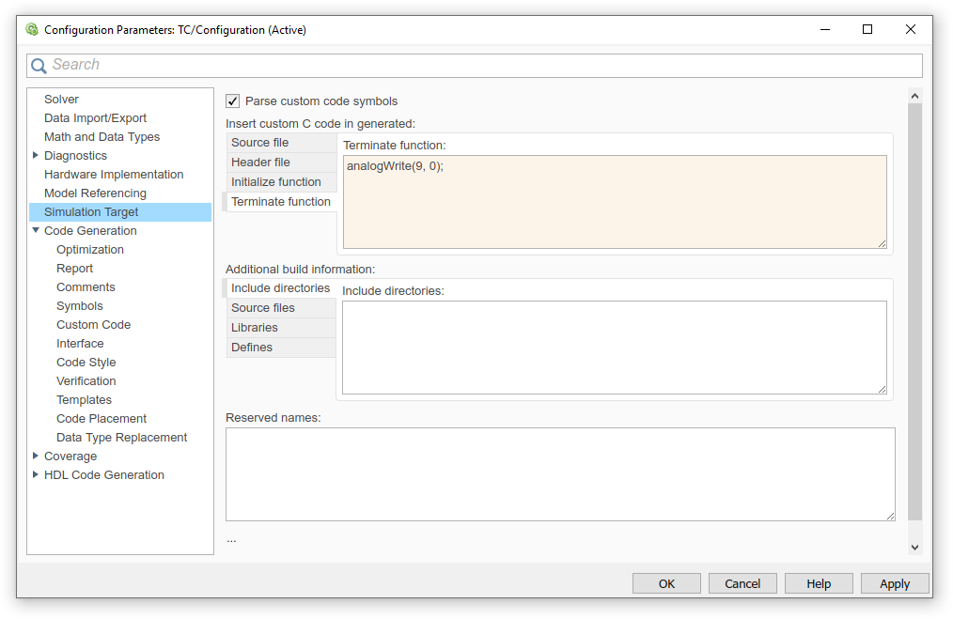
Configure your Simulink

Slide 8
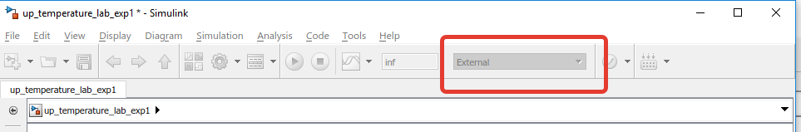
Configure your Simulink
The Simulink is set to the external mode

Slide 9
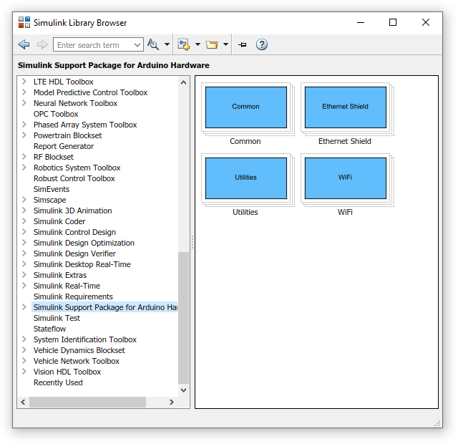
Configure your Simulink
Make sure your system works perfectly.
Open your Simulink, find the “Simulink Library Browser”

Slide 10
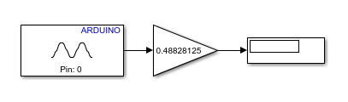
Check the temperature readings
Calibration gain
Write the value down before you turn the heating system on as this will be your ambient temperature value.

Slide 11
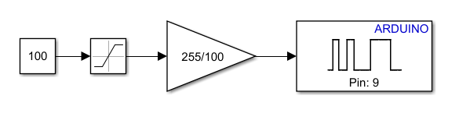
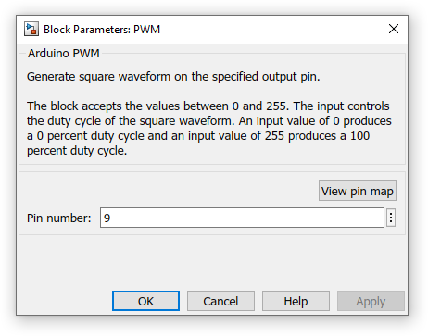
Check your PWM output, is the resistor getting hot?
Input is in percent (0-100%)
Saturation from 0 to 100
(sanity check)
Takes value from 0 to 255
We use Pin #9

Slide 12

Notes:
Notes:

Slide 13
Notes:
Notes:

